Slide 1
Programming Refresher
Notes:
Let's start with a quick refresher on Python programming basics.

Slide 2
Python Data Types and Operators
Notes:
Let’s learn about the fundamental data types and operators that form the building blocks of Python programming

Slide 3
Identify various Python data types to handle diverse data efficiently
Assign different data types to Python variables to manage data effectively
Write and test Python code that demonstrates the use of arithmetic, assignment, comparison, logical, and miscellaneous operators
Manipulate strings using Python string functions to enhance text processing capabilities
Notes:
Read the learning objectives

Slide 4
Business Scenario
A software development company is organizing a training session on Python data types, operators, and string functions. The goal is to enhance the team's understanding of these fundamental concepts. This will improve their ability to handle diverse data, perform efficient operations, and manipulate strings effectively. The training will equip the team with essential Python programming skills.
As a result, they will achieve higher code quality, optimized performance, and increased productivity when delivering exceptional software solutions to clients.
Notes:
Elaborate each scenario and discuss with the class.

Slide 5
Data Types and Data Assignment
Notes:
Let’s explore the various data types in Python and learn how to assign values to variables.

Slide 6
Data Types
Variables can store various kinds of data; each has a specific function. Objects represent data.
Scalar data
Integer: 2323, 10
Float: 32.3, 31.2e5
Boolean: True , False
Complex: 2 + 6j
Types of data
Aggregated data
String: “abc” , ‘xyz’
Set: {2, 4, 6, ‘abc’}
List: [23, 9.8, ‘a’, ‘b’, ‘a’]
Tuple: (34.5, ‘a’ , 45, ‘w’)
Dictionary: {‘a’ : 1 , ‘b’ : 3}
Note
The data type of any object can be checked by using the built-in function type().
Notes:
This slide is self explanatory

Slide 7
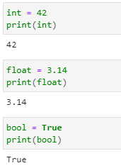
Scalar Data
Scalar data types represent a single value. The following are the syntax and examples of scalar data:
Integer represents whole numbers without a fractional part.
Float represents real numbers with a fractional part.
Boolean represents two values, either True or False.
Notes:
Scalar data types represent a single value. These are the basic building blocks in Python and are used to store individual data points.

Slide 8
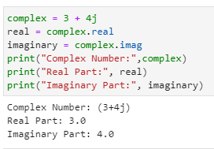
Scalar Data
Scalar data types represent a single value. The following are the syntax and examples of scalar data:
The complex data type in Python represents complex numbers.
Complex numbers are expressed as a + bj, where a is the real part, and b is the imaginary part.
Notes:
This slide is self explanatory

Slide 9
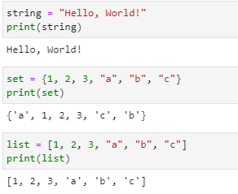
Aggregated Data
Aggregated data types represent collections of values. The following are the syntax and examples of aggregated data:
String represents sequences of characters enclosed in single, double, or triple quotes.
Set is an unordered collection of unique items in Python.
List is an ordered collection of items, which can be of different types.
Notes:
Aggregated data types represent collections of values. These can store multiple items, which can be of the same type or different types.

Slide 10
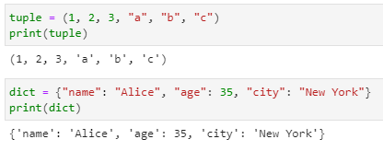
Aggregated Data
Aggregated data types represent collections of values. The following are the syntax and examples of aggregated data:
Tuple is an ordered collection of items that are of different types.
Dictionaries are an unordered collection of key-value pairs.
Notes:
This slide is self explanatory

Slide 11
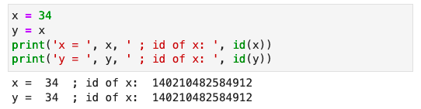
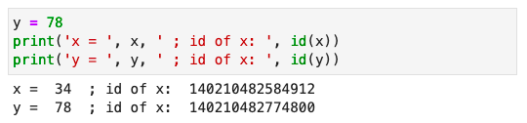
Data Assignment
Python variables are references to objects, but actual data is contained in the objects.
Here, x and y point to the same memory location where 34 (an integer object) is stored.
Here, y points to a new integer object with 78 as a value, and x points to the previous object with 34.
These references can be verified by using the id() function.
Notes:
In Python, variables act as references to objects rather than directly storing the data. The actual data is contained within the objects themselves.
When you assign a value to a variable, it doesn't store the data directly. Instead, it refers to an object that holds the data. The variable serves as a label or reference to access and manipulate the underlying object.

Slide 12
Operators in Python
Notes:
Explore various operators in Python and their usage in performing different operations.

Slide 13
Operators
Operators in Python are special symbols or keywords that perform computations.
The following are the purposes of operators:
Operators are symbols that tell the interpreter to perform specific mathematical, relational, or logical operations to produce a result.
Operators operate on operands, which are the values or variables on which the operation is performed.
Notes:
This slide is self explanatory.

Slide 14
Operators
The different types of operators are given below:
Arithmetic
operators
Miscellaneous operator
Assignment operators
Logical
operators
Comparison operators
Notes:
Python supports a variety of operators, each serving a specific purpose. Here’s an overview of the different types of operators in Python.

Slide 15
Arithmetic Operators
Different arithmetic operators are given below with an example:
Operator | Description | Example
+ | Addition | >> x = 12 ; y = 50 >> x + y 62
- | Subtraction | >> x = 45 ; y = 24 >> x - y 21
* | Multiplication | >> x = 50 ; y = 4 >> x * y 200
/ | Division | >> x = 50 ; y = 4 >> x / y 12.5
Notes:
This slide is self explanatory.

Slide 16
Arithmetic Operators
Different arithmetic operators are given below with an example:
Operator | Description | Example
% | Modulo | >> x = 50 ; y = 4 >> x % y 2
// | Integer divide | >> x = 50 ; y = 4 >> x // y 12
** | Exponent | >> x = 5 ; y = 4 >> x ** y 625
Notes:
This slide is self explanatory.

Slide 17
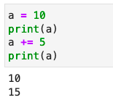
Assignment Operators
The equal to “=“ operator is used for data assignment in Python.
Example:
Assignment operators can be combined with arithmetic operators.
Here, a += 5 is the same as a = a + 5.
Similar operators are: -= , *=, /=, %=, //=, and **= .
Notes:
The assignment operator allows you to store data in variables, making them accessible for further use in your code.

Slide 18
Comparison Operators
Comparison operators are used to compare two values.
Operator | Description | Example
== | Returns True when the two values are equal | >> x = 20 ; y = 20 >> x == y True
!= | Returns True when the two values are not equal | >> x = 45 ; y = 24 >> x != y True
Note
These operators return true or false based on the comparison.
Notes:
Comparison operators in Python are used to compare two values and evaluate their relationship. These operators return a Boolean value (True or False) based on the result of the comparison.

Slide 19
Comparison Operators
Comparison operators are used to compare two values.
Operator | Description | Example
< | Returns True when the first value is less than the second | >> x = 20 ; y = 30 >> x < y True
> | Returns True when the first value is greater than the second | >> x = 40 ; y = 30 >> x > y True
Note
These operators return true or false based on the comparison.
Notes:
This slide is self explanatory.

Slide 20
Comparison Operators
Comparison operators are used to compare two values.
Operator | Description | Example
<= | Returns True when the first value is less than or equal to the second | >> x = 10 ; y = 30 >> x <= y True
>= | Returns True when the first value is greater than or equal to the second value | >> x = 30 ; y = 30 >> x >= y True
Note
These operators return true or false based on the comparison.
Notes:
This slide is self explanatory.

Slide 21
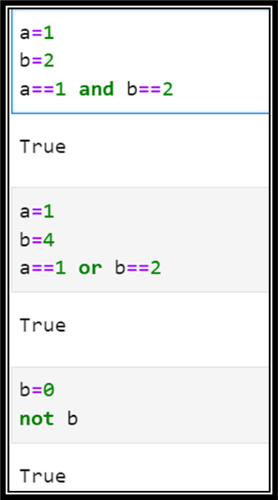
Logical Operators
Logical operators are used for combining conditional statements.
Operator | Description
and | Returns True if both statements are true
or | Returns True if one of the statements is true
not | Reverses the results, returns True if the result is false
Notes:
Logical operators in Python are used to combine and manipulate conditional statements. These operators allow you to create complex conditions by combining multiple individual conditions.

Slide 22
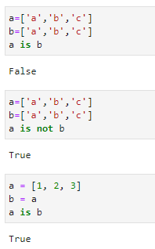
Miscellaneous Operators
Miscellaneous operators are used for specific operations compared to arithmetic, logical, and comparison operators. There are two types of miscellaneous operators:
1. Identity Operators
Identity operators compare variables to see whether they are the same object at the same memory address.
is: Returns True if both variables are the same object
is not: Returns True if both variables are not the same object
Notes:
Miscellaneous operators in Python include identity operators and membership operators. These operators are used for more specific operations compared to arithmetic, logical, and comparison operators.
1. Identity Operators:
- `is`: Checks if two operands refer to the same object.
- `is not`: Checks if two operands do not refer to the same object.

Slide 23
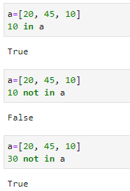
Miscellaneous Operators
2. Membership Operators
Membership operators test if a sequence is present in an object.
in: Returns True if a value is present in the object
not in: Returns True if a value is not present in the object
Notes:
In Python, there are two kinds of miscellaneous operators:
2. Membership Operators:
- `in`: Checks if a value is present in a specified sequence or container.
- `not in`: Checks if a value is not present in a specified sequence or container.

Slide 24
Strings in Python
Notes:
Let’s explore the various string functions in Python.

Slide 25
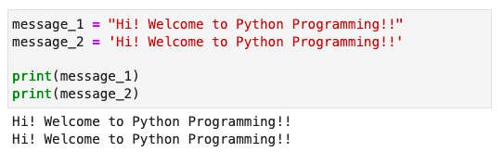
Strings
Strings are a sequence of characters that can be either letters or alphanumeric.
Strings in Python are enclosed in either single or double quotation marks.
In the above example, the values of message_1 and message_2 are the same.
Notes:
In Python, strings are sequences of characters that can contain letters, numbers, symbols, and whitespace. They are used to represent and manipulate textual data.

Slide 26
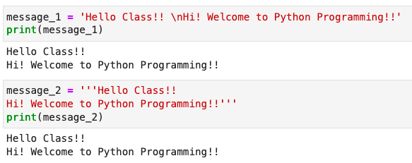
Strings
Triple single quotes (‘’’... ‘’’) or triple double quotes (""" ... ""”) can create multiline strings in Python.
In the above example, the values of message_1 and message_2 are similar.
Notes:
This slide is self explanatory.

Slide 27
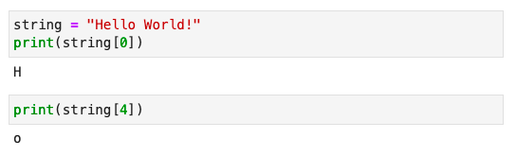
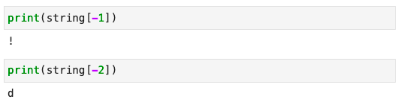
Accessing Characters in Strings
Strings can be accessed by using subscripts or indexes. Indexing in Python starts with 0.
The characters of the string can be accessed as:
Explanation
0 | 1 | 2 | 3 | 4 | 5 | 6 | 7 | 8 | 9 | 10 | 11
H | e | l | l | o |  | W | o | r | l | d | !
The last character or reverse of the string can be accessed as:
-12 | -11 | -10 | -9 | -8 | -7 | -6 | -5 | -4 | -3 | -2 | -1
Notes:
In Python, you can access individual characters within a string using subscripts or indexes. The indexing of strings starts from 0, where the first character is at index 0, the second character is at index 1, and so on.
Positive Indexing: Access characters from the beginning using indices starting from 0.
Negative Indexing: Access characters from the end using indices starting from -1.

Slide 28
String Functions
Methods | Description
capitalize | Returns a string in sentence case, which means that the first letter is upper case, and the rest is lower case
lower | Returns a copy of the string converted to lowercase
upper | Returns a copy of the string converted to uppercase
strip | Returns a copy of the string with leading and trailing whitespace removed
join | Concatenates any number of strings
split | Divides a string into a list of substrings based on a specified delimiter
Strings are immutable Python objects.
All string methods return a new value and do not change the original string.
Notes:
This slide is self explanatory.

Slide 29
Assisted Practice : Data Types, Operators, and Strings
Objective: In this demonstration, we will learn more about data types, operators, and strings in Python.
Tasks to perform:
1. Introduce data types
2. Use operators in Python
3. Understand strings
Note
Please refer to the Reference Material section to download the Jupyter Notebook files for the mentioned topic.
Notes:
This slide is self explanatory.

Slide 30
File Handling in Python
Notes:
Let's delve into file handling in Python.

Slide 31

File Handling in Python
File operations are fundamental actions performed on files, including creating, reading, writing, and closing.
These operations are crucial for data manipulation, storage, and transfer in programming, and Python provides built-in functions and methods for handling these tasks efficiently.
Notes:
File handling is an essential part of many programs and applications. Python provides built-in functions and methods for creating, reading, writing, and closing files. These operations are crucial for data manipulation, storage, and transfer.

Slide 32
Creating and Opening a File
To open a file in Python, use the open() function. If the file does not exist, opening it in write (w) or append (a) mode can create it.
Syntax:
file = open('example.txt', 'w')
Notes:
Trainer Note: For the detailed example, please refer to the notebook named Lesson_04_File_Handling_in_Python.

Slide 33
Reading from a File
To read the entire content of a file, use the read() method:
Syntax:
content = file.read()
print(content)
To read one line at a time, use the readline() method, and for reading all lines into a list, use readlines():
Syntax:
line = file.readline()
print(line)
lines = file.readlines()
print(lines)
Notes:
Trainer Note: For the detailed example, please refer to the notebook named Lesson_04_File_Handling_in_Python.

Slide 34
Writing to a File and Closing a File
Use the write() method to write a string to a file, and writelines() for a list of strings:
Syntax:
file.write('Hello, world!\n')
lines = ['First line\n', 'Second line\n']
file.writelines(lines)
Close a file after the operations are complete to free up system resources.
Syntax:
file.close()
Notes:
Trainer Note: For the detailed example, please refer to the notebook named Lesson_04_File_Handling_in_Python.

Slide 35
Assisted Practice : File Handling in Python
Objective: In this demonstration, we will learn more about file handling in Python.
Tasks to perform:
1. Read a file
2. Write to a file
3. Append to a file
4. Read after writing
5. Read line by line
6. Write strings and close the file
Note
Please refer to the Reference Material section to download the Jupyter Notebook and the Dataset files for the mentioned topic.
Notes:
This slide is self explanatory.

Slide 36
Error Handling in Python
Notes:
Let's delve into error handling in Python.

Slide 37
Introduction to Error Handling
It is the process of managing errors or exceptions that occur during the execution of a program providing an appropriate message to the developer.
The program encounters unexpected situations like a missing file, invalid user input, or division by zero, and an error gets raised.
The program stops abruptly when these errors occur without error handling.
The program allows for managing errors gracefully, recovering from them, or displaying user-friendly messages, ensuring it runs more smoothly and reliably.
Notes:
Instructor Notes: Walk through each bullet point explaining the importance of error handling:
First bullet: Mention common unexpected situations that could cause errors (e.g., missing files, invalid inputs, or divide-by-zero scenarios). Emphasize that when these errors occur, an exception is raised.
Second bullet: Explain that without error handling, the program would crash and stop executing, which would be undesirable.
Third bullet: Explain how error handling helps manage errors gracefully by allowing the program to either recover or display helpful error messages for the user.

Slide 38
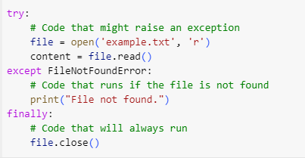
Error Handling in Python: Example
Python provides a way to manage errors using the below blocks:
try: This block contains code that might raise an exception (e.g., attempting to open a file that might not exist).
except: If the try block raises a specific exception (e.g., FileNotFoundError), this block will execute, handling the error gracefully.
finally: This block always runs, regardless of whether an exception occurred or not; it is used for clean-up actions, like closing files or releasing resources.
Notes:
Instructor Notes:
Introducing the example: opening a file, handling a potential error if the file isn’t found, and ensuring that the file is always closed.
Explain each block in the example:
try: This block attempts to open the file. If the file doesn’t exist, an exception will be raised.
except FileNotFoundError: If a FileNotFoundError occurs, this block catches the error and displays a message indicating that the file wasn’t found.
finally: No matter what happens, this block ensures the file is closed, whether it was successfully opened or not.

Slide 39
Assisted Practice : Error Handling in Python
Objective: In this demonstration, we will explore how error handling works in Python by using try, except, and finally blocks to manage file operations.
Tasks to perform:
Prompt the user for a file name
Attempt to open and read the file contents
Catch the FileNotFoundError if the file does not exist
Display the file contents if the file is found
Ensure that the file is always closed, whether or not an error occurred
Note
Please refer to the Reference Material section to download the Jupyter Notebook and the Dataset files for the mentioned topic.
Notes:
Instructor Notes: Please demonstrate this in the session.

Slide 40
In Python, data is represented as objects. ​
Python supports different types of operators, such as arithmetic, comparison, logical, and miscellaneous operators.​
Strings are immutable objects in Python.​
Strings can be accessed by using subscripts or indexes. ​
All string methods return a new value and do not change the original string.​
Notes:
Read the key takeaways

Slide 42
__________ operators test if a sequence is present in an object.​
1
Membership​
Logical​
Comparison​
All of the above​

Slide 43
__________ operators test if a sequence is present in an object.​
1
Membership
Logical​
Comparison​
All of the above​
A
Membership operators test if a sequence is presented in an object.​

Slide 44
String indexing in Python starts with _________.​
2
2
1
0
All of the above​

Slide 45
String indexing in Python starts with _________.​
2
2
1
0
All of the above​
C
String indexing in Python starts with 0.​

Slide 46
Thank You!
Notes:
Thank you

